Slide 1
Azure
IOT Hub

Slide 2

Maik van der Gaag
Name: Maik van der Gaag
Function: Application Architect at Motion10
Email: maik.vandergaag@motion10.com
Expertise: Office365,
Azure,
VSTS
Twitter: @maikvandergaag
Blog: https://msftplayground.com

Slide 3
Agenda
Azure
Azure IOT Hub
Azure Stream Analytics

Slide 4
Azure
Microsoft Azure is a collection of integrated cloud services:
Analytics
Computing
Database
Mobile
Networking
Storage
Web

Slide 5
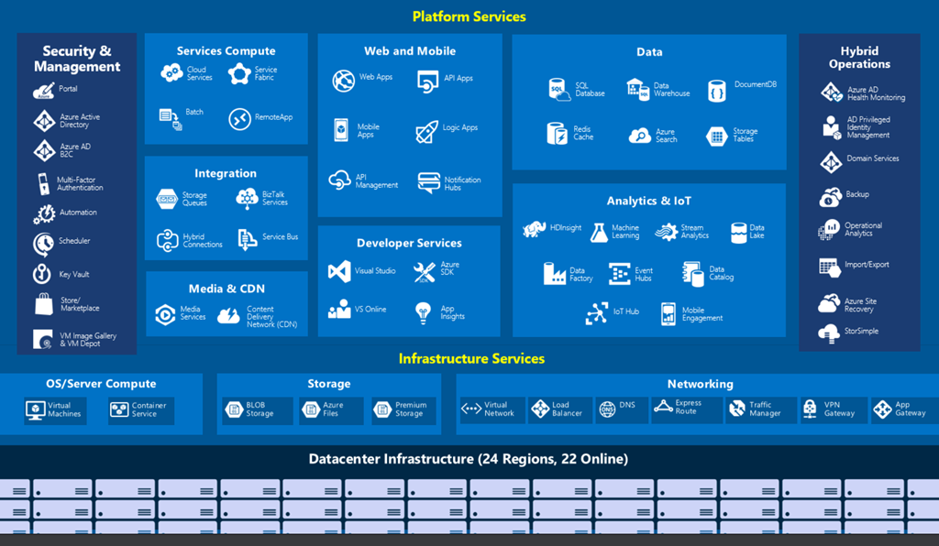

Slide 6


Models
On-Premise
Infrastructure
(as a Service)
Platform
(as a Service)
Software
(as a Service)
Applications
Applications
You manage
Applications
Applications
Data
You manage
Data
Data
Data
Runtime
Runtime
Runtime
Runtime
Managed by vendor
You manage
Middleware
Middleware
Middleware
Middleware
Managed by vendor
O/S
O/S
O/S
O/S
Virtualization
Virtualization
Managed by vendor
Virtualization
Virtualization
Servers
Servers
Servers
Servers
Storage
Storage
Storage
Storage
Networking
Networking
Networking
Networking

Slide 7
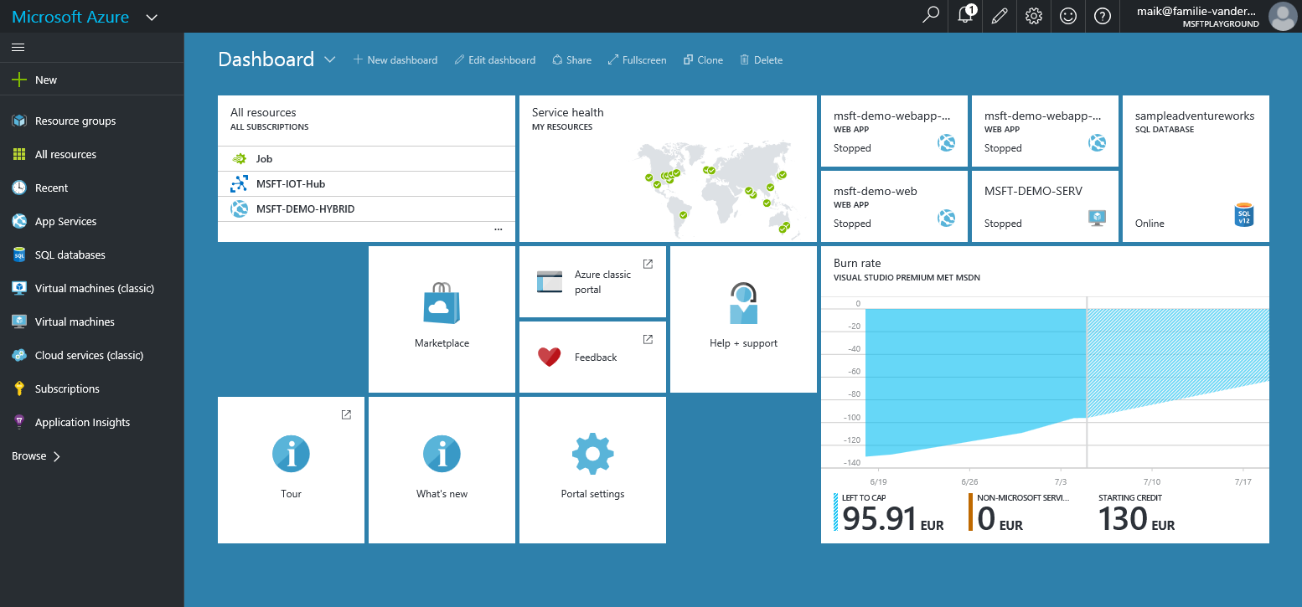
Azure Portal

Slide 8
Azure IOT Hub
Azure IoT Hub is a fully managed service that enables reliable and secure bidirectional communications between IoT devices and a solution back end.
Provides reliable device-to-cloud and cloud-to-device messaging at scale.
Enables secure communications using per-device security credentials and access control.
Provides extensive monitoring for device connectivity and device identity management events.
Includes device libraries for the most popular languages and platforms (SDK)
Notes:
Azure IOT Simplifies the connection to the devices you use.

Slide 9
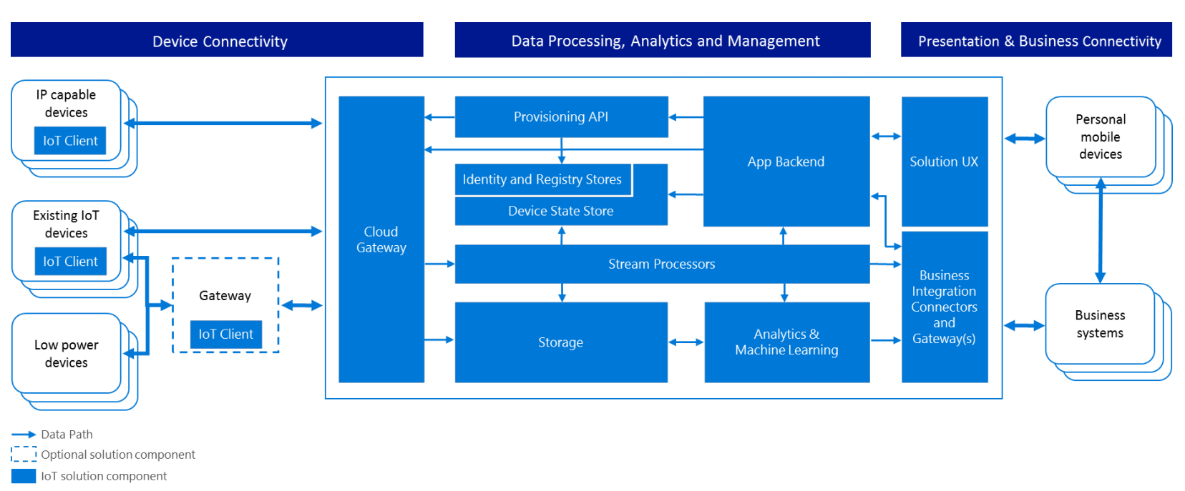
IOT Reference Architecture

Slide 10






Network and cloud services in a IoT infrastructure
Devices
Gather
Distribute
Read
Route
Transform
Analyze
Save
Process
Act
Present
Predictive analysis
Machine
Learning
Stream Analytics
Sensors
HDInsight
Power BI
IoT Hub & Event hubs
DocumentDB
Actors
Cloud gateways (web APIs)
Stream processing
Azure storage
API & Logic Apps
Smartphones
Storage adapters
Service Bus
Field Gateways
Hubs
BizTalk Services

Slide 11
Azure IoT Suite Remote Monitoring solution
Power BI
Azure
Web/Mobile App
Active Directory
Devices
Back end systems and processes
Storage blobs
DocumentDB
Logic Apps
C# simulator
IoT Hub
Stream Analytics
Event Hub
Web Jobs

Slide 12














The moving parts of a Microsoft based IoT solution
Devices | Device Connectivity | Storage | Analytics | Presentation & Action
 | Event Hub | SQL Database | Machine Learning | App Service
 | IoT Hub | Table/Blob Storage | Stream Analytics | Power BI
 | Service Bus | DocumentDB | HDInsight | Notification Hubs
 | External Data Sources | 3rd party Databases | Data Factory | Mobile Services
 |  |  | Data Lake | BizTalk Services
{ }

Slide 13
Azure Stream Analytics
Azure Stream Analytics is a cost effective event processing engine that helps uncover real-time insights from devices, sensors, infrastructure, applications, and data.
Low cost: Stream Analytics is architected for multi-tenancy meaning you only pay for what you use and not for idle resources. Unlike other solutions, small streaming jobs will be cost effective.
Faster developer productivity: Stream Analytics allow developers to use a SQL-like syntax that can speed up development time from thousands of lines of code down to a few lines. The system will abstract the complexities of the parallelization, distributed computing, and error handling away from the developers.
Elasticity of the cloud: Stream Analytics is built as a managed service in Azure. This means customers can spin up or down any number of resources on demand. Customers will not have to setup costly hardware or install and maintain software.

Slide 14
What – Azure Stream Analytics
Real-time ingestion, processing and archiving of data: Use Stream Analytics to ingest a continuous stream of data and do in-flight processing like scrubbing information, adding geo-tagging, and doing IP lookups before being sent to a data store.
Real-time Analytics: Use Stream Analytics to provide real-time dashboarding where customers can see trends that happen immediately when they occur.
Connected devices (Internet of Things): Use Stream Analytics to get real-time information from their connected devices like machines, buildings, or cars so that relevant action can be done. This can include scheduling a repair technician, pushing down software updates or to perform a specific automated action.

Slide 15
Labs
Lab 1 - Create a IOT Hub
Lab 2 - Add a device to the IOT Hub
Lab 3 - Create Azure Stream Analytics
Lab 4 - Process data with Stream Analytics

